Slide 1
Real-Time Pretty Pictures
Matthew McMullan & Ian Ooi

Slide 2
Our Goals
Implement Real-Time Hatching
Create outlines for Objects
Texture-map with cel-shading
Make it real-time
Pretty Pictures

Slide 3
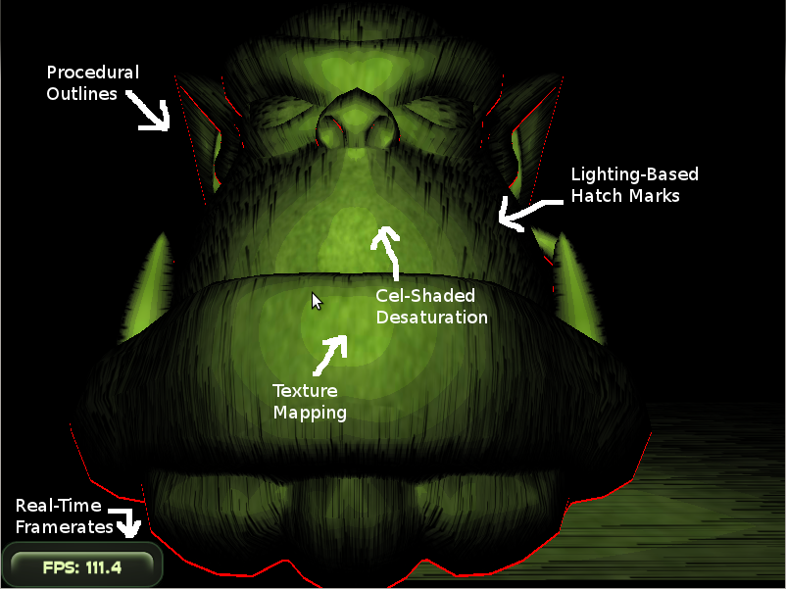
Results

Slide 4
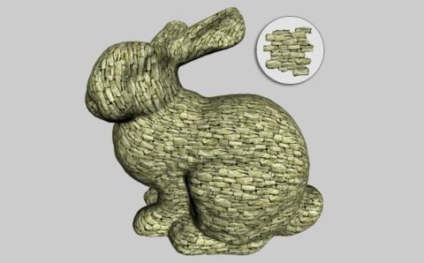
Prior Work
Cel-shading
  numerous methods, discussed a bit in Cartoon Looking Rendering of 3D Scenes (Decaudin)
  mainly found sources on help forums for Cg (nVidia and Microsoft sites) as well as the OGRE forums
Drawing Outlines/Sobel Filter
  wanted simpler methods of drawing cartoon outlines to be able to run in realtime
Lapped Textures (Praun, Finkelstein, Hoppe)
  for future work to improve the mapping of the textures (and therefore improve the hatching effect)

Slide 5
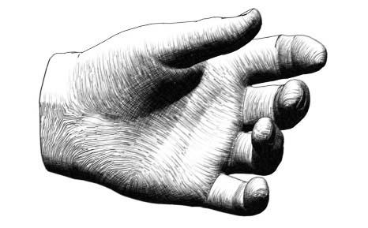
Prior Work: Real Time Hatching (Praun, Hoppe, Webb, Finkelstein)
Render objects using hatching
Hatching is achieved through the use of tonal art maps (TAMs)
  Generate randomly
  Toroidal to allow tiling
  Important notes:
    all of the lines contained in the smaller levels of the mipmap are present in the large version of the mipmap to allow for blending
    all of the lines in the lighter images are contained in the darker images, also for blending

Slide 6
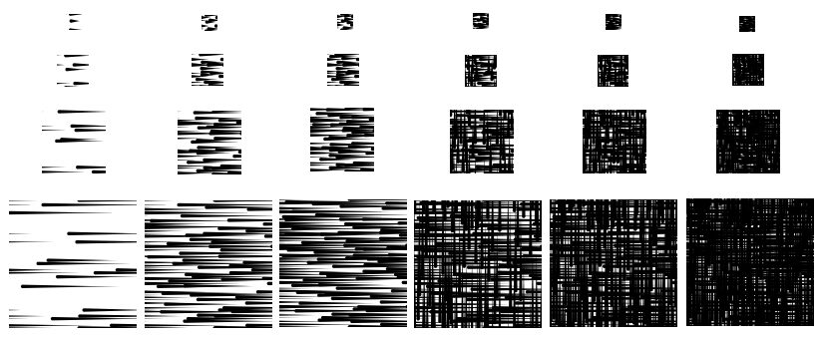
TAM generation
Generated offline through separate program
Stored as N custom mipmap level in six .dds textures (R8G8B8A8 format)
(additional levels omitted)

Slide 7
Basic Set-up
OGRE to handle rendering
  Scene management, handles cameras and lights, infrastructure for shaders and textures/mipmaps
Simple texture mapping
  used models with simple mappings like planes

Slide 8
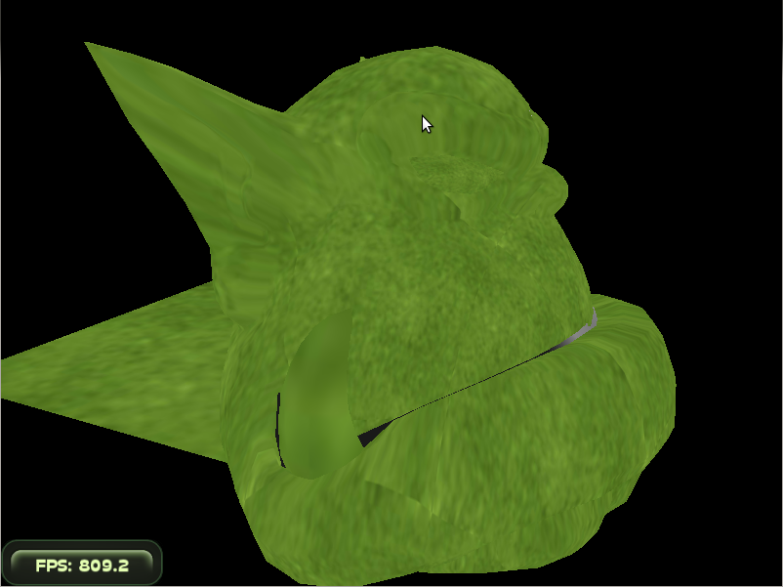
Texture Mapping

Slide 9
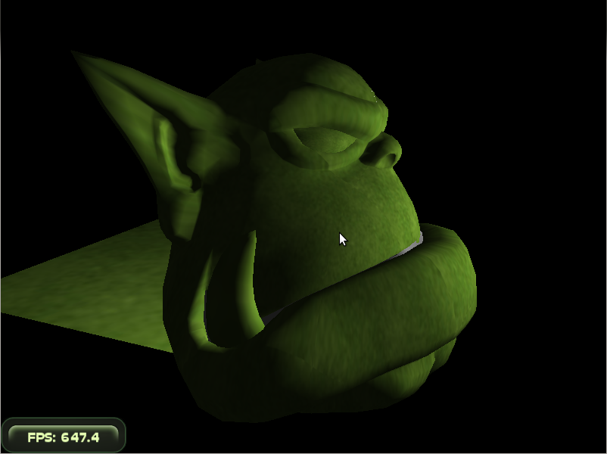
Per-Pixel Lighting

Slide 10
Hatching
calculate brightness as the average of r, g and b values
based off of the brightness value, choose which of the textures in the TAM to blend and assign their weights
shade the surface with the blended TAMs instead of modifying the color value
Adapted to per-pixel lighting

Slide 11
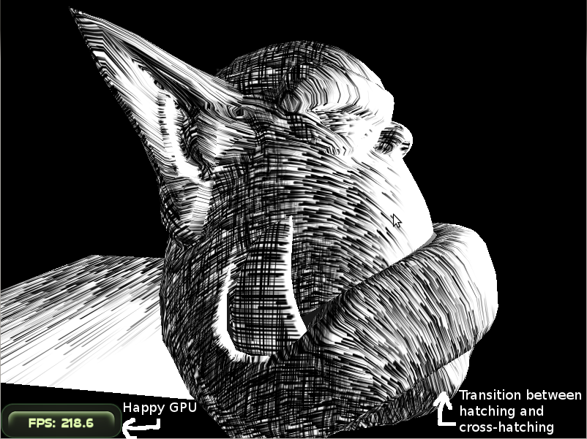
Hatching

Slide 12
Outlines: Sobel Filter
Ideally uses the depth and calculates to find edges
Currently uses color information
Applied as a post processing effect

Slide 13
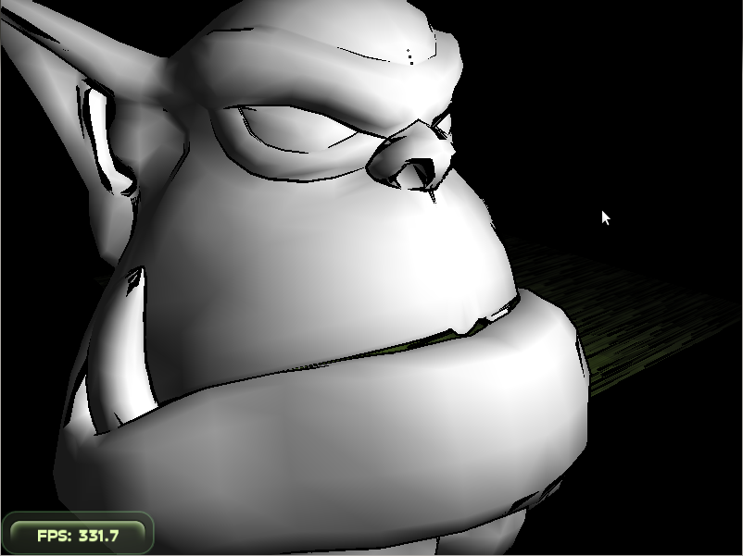
Sobel Filter

Slide 14
Outlines: Dual Geometry
Redraw the geometry slightly outside the original geometry with black (or other colored) faces
cull the front faces (cull clockwise in ogre)

Slide 15
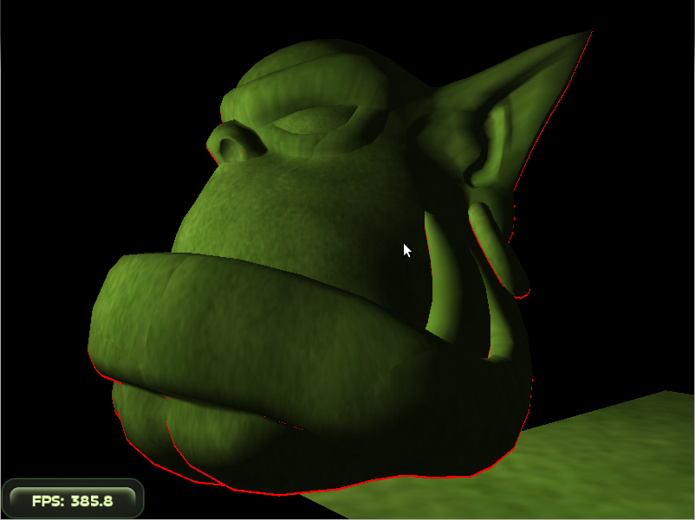
Outlines (Highlighted)

Slide 16
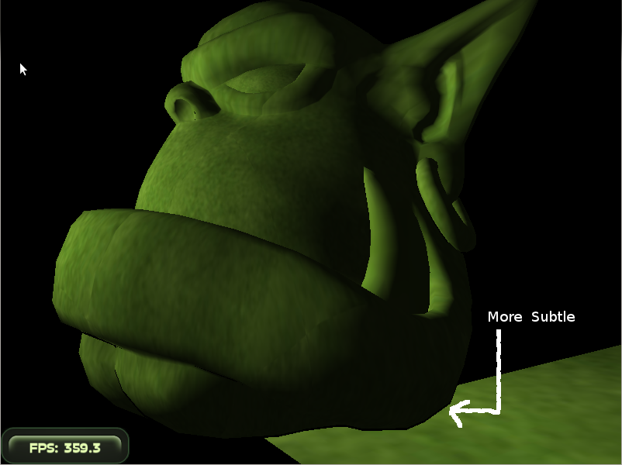
Outlines

Slide 17
Cel-Shading: Original Method
Turned the color values into a step-function
There are 2 methods
  Indexed colors use a lookup table for translating the color into the new color
  We calculated the new color by applying a threshhold

Slide 18
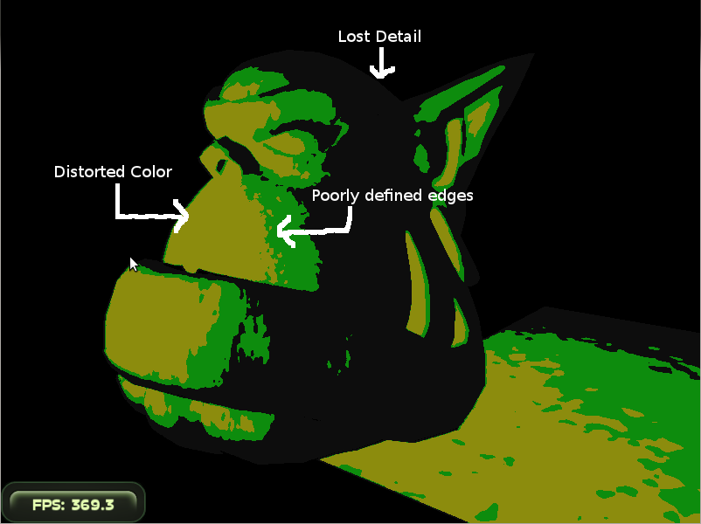
Cel-Shading

Slide 19
This Slide Intentionally Left Blank

Slide 20
Cel-Shading: Desaturation
Apply lighting to temporary color
Turn the brightness (L term of HSL) into a step function
Translate the change in brightness to saturation
Apply the change in brightness and saturation to the final texture map, preserving lighting and surface colors

Slide 21

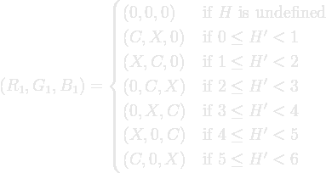

HSL to RGB

Slide 22

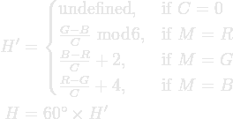

RGB to HSL

Slide 23
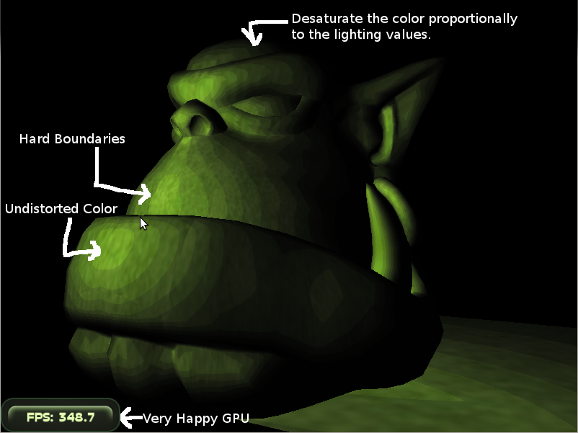
Cel-Shading

Slide 24
Results

Slide 25
Questions?

